Slide 1
Loopway AI – Applied AI Platforms
Enterprise-grade AI systems for real-world applications

Slide 2
Our AI Portfolio
BuildWise – AI-Enabled Construction Planning & Decision Assistant
NexSense – Smart City & Infrastructure Intelligence

Slide 3
BuildWise — AI-Enabled Construction Planning & Decision Assistant
BuildWise is an AI-driven platform that helps builders, planners, and trade partners move from plans + requirements → structured decisions, options, and budgets — with reliability, citations, and workflow continuity.
It demonstrates Loopway’s strength in:
structured outputs
deterministic JSON contracts
multimodal plan analysis
retrieval-augmented reasoning
workflow-aware UX

Slide 4
Core AI Architecture
BuildWise uses a structured AI orchestration stack designed for predictable outputs:
LangChain orchestration with schema-enforced responses
Zod-based deterministic structured JSON parsers
OCR + PDF parsing pipeline (plans, specs, images)
Metadata tagging (rooms, trades, sheets, levels)
Chunking + embeddings for targeted retrieval
Vector search for semantic relevance
RAG with citations and evidence references
This ensures the system:
returns stable, machine-consumable outputs
supports composable UI rendering
avoids free-form hallucinated responses
integrates cleanly into planning & budget workflows

Slide 5
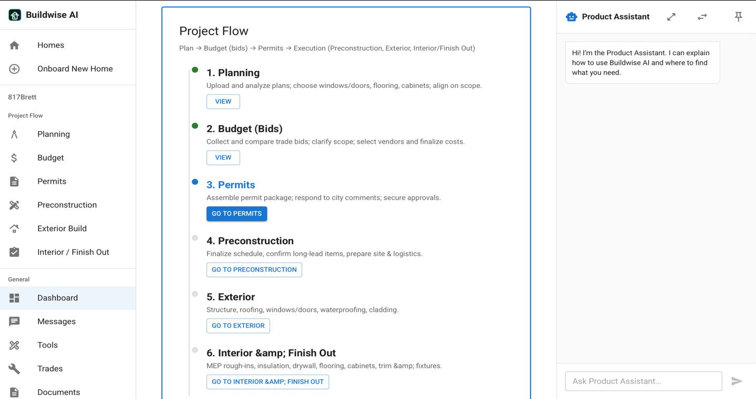

Slide 6
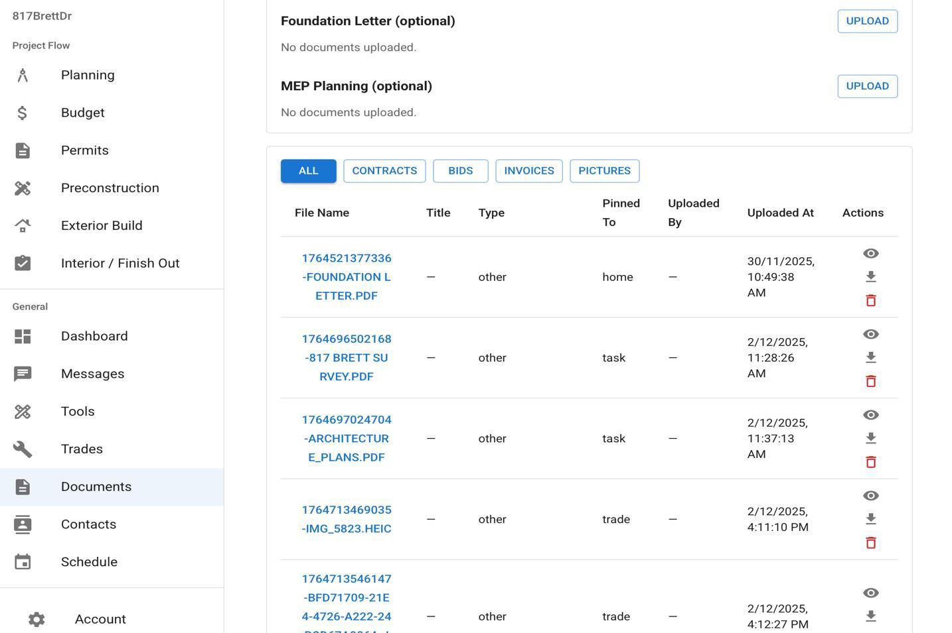
Knowledge Center & Multimodal Ingestion
BuildWise ingests:
plans & blueprints (PDF)
images and annotated markups
trade documents
customer requirements
Pipeline includes:
OCR + LLM parsing
text normalization
structural metadata extraction
chunking by:
home / project
trade
sheet / page
region (when coordinates exist)
These chunks feed the vector index, enabling:
high-precision retrieval
trade-specific context targeting
source-aware reasoning

Slide 7
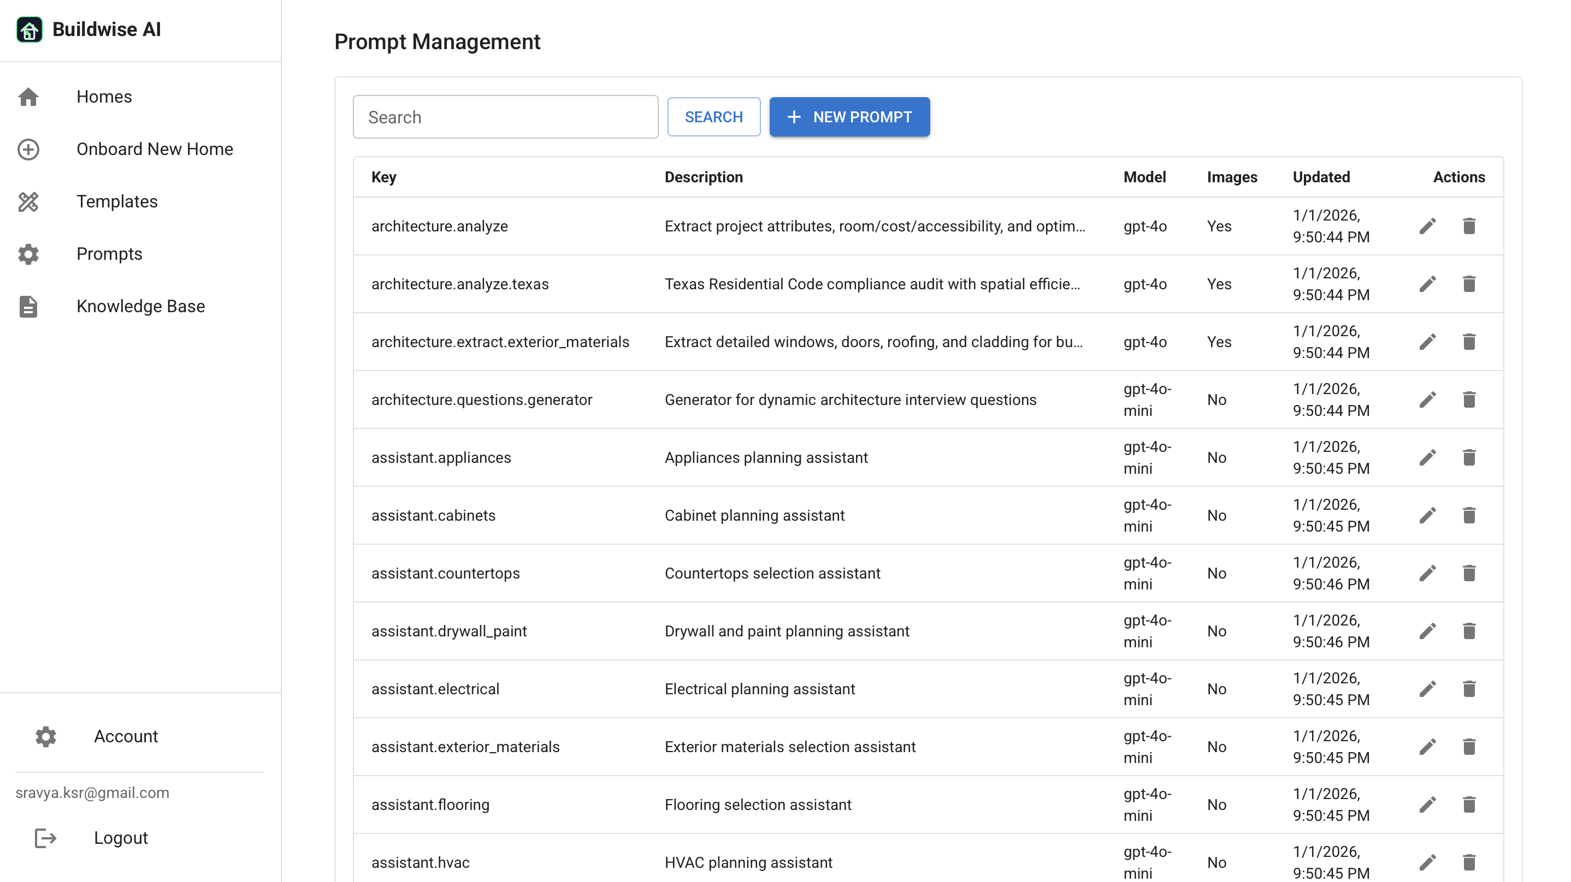
Structured RAG Responses
When a user asks a question or runs an analysis:
Relevant chunks are retrieved
Context is packed with sources
The LLM returns strict JSON including:
answer summary
comparison tables
option cards
follow-up actions
citations & document references
This supports:
explainable decisions
repeatable workflows
auditable rationale

Slide 8
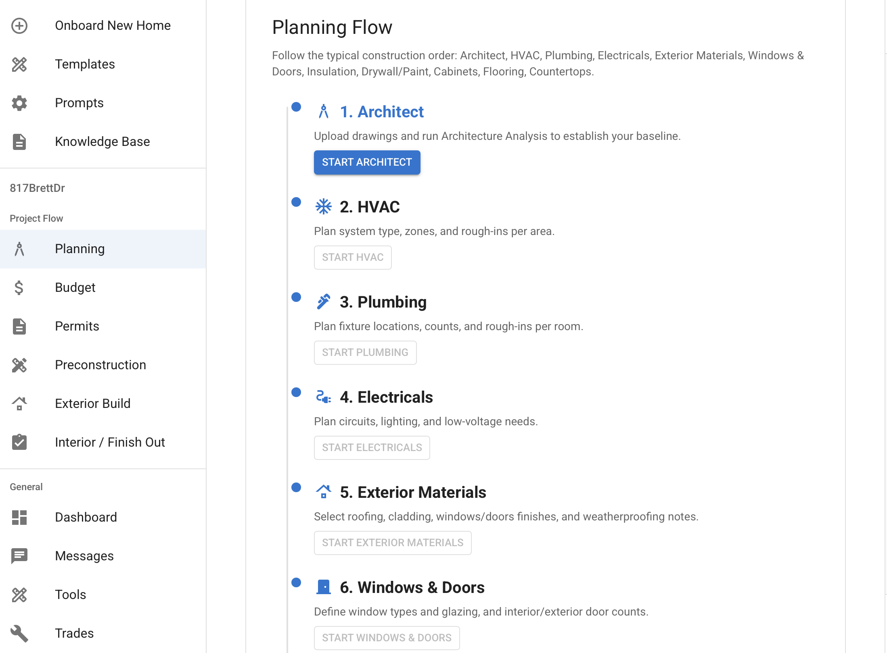
Plan Analysis + Requirements Fusion
BuildWise fuses:
plan analysis results
customer-stated requirements
trade logic & domain knowledge
Examples:
room & area detection
trade planning (HVAC zones / tonnage ranges)
capacity guidance
cost band estimation
recommended configuration options
Outputs are packaged as:
structured planning summary
per-trade breakdown
cost & execution guidance

Slide 9
Rich Structured Chat + Workflow UI
The chat experience renders structured AI outputs, including:
comparison tables
option cards (pros / cons / attributes / ranges)
follow-up prompts as action chips
planning → budgeting workflow transitions
Users can:
refine decisions
branch scenarios
attach docs & plans
move outputs into budgeting
BuildWise functions as a:
Planning + Knowledge + Structured Decision AI layer for construction workflows

Slide 10
Nexsense — Smart-City Digital Twin & Vision AI Intelligence Platform
Nexsense is a smart-city operations intelligence platform combining:
Vision AI
IoT & sensor telemetry
crowd & traffic analytics
incident detection & correlation
AI-assisted operator workflows
Where BuildWise focuses on plan intelligence, Nexsense focuses on city &
infrastructure intelligence.

Slide 11
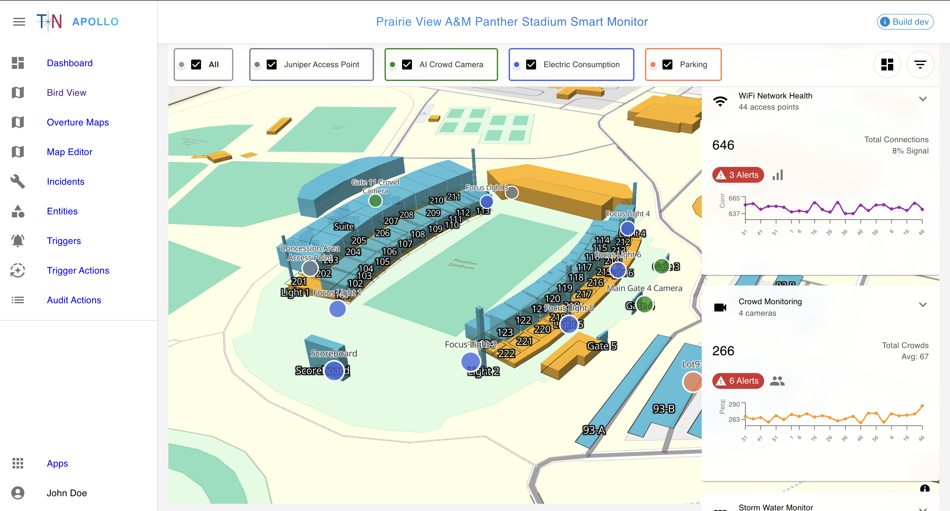

Slide 12
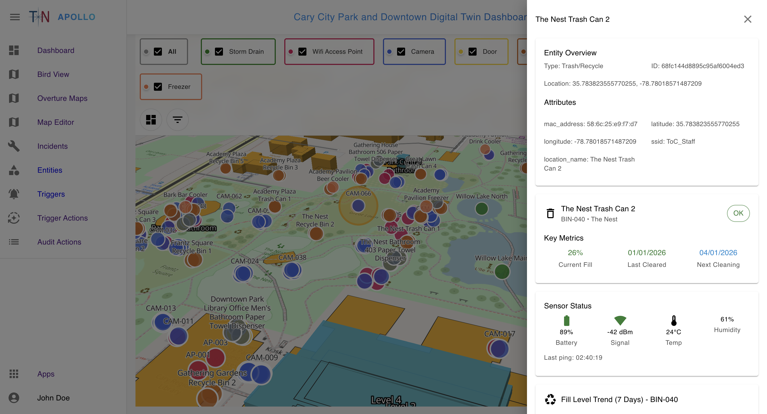
Smart-City Data Fusion Core
Nexsense ingests:
camera snapshots & detections
incident clips
IoT telemetry streams
asset & zone metadata
historical event logs
Data is normalized into:
assets
zones
cameras
events
time-series traces
This powers:
real-time situational awareness
correlation analysis
temporal pattern discovery

Slide 13
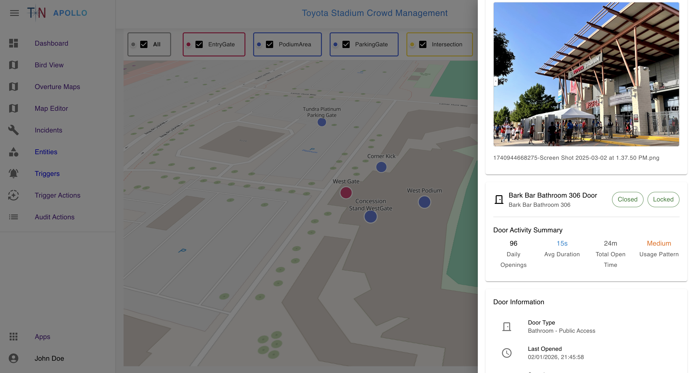
Vision AI Capabilities
Nexsense applies Vision AI for:
crowd density estimation
queue & congestion analytics
pedestrian–vehicle interaction awareness
risk-zone monitoring
near-miss event detection
safety hazard indicators
Outputs include:
event type
confidence score
affected assets / zones
severity level
recommended operator actions

Slide 14
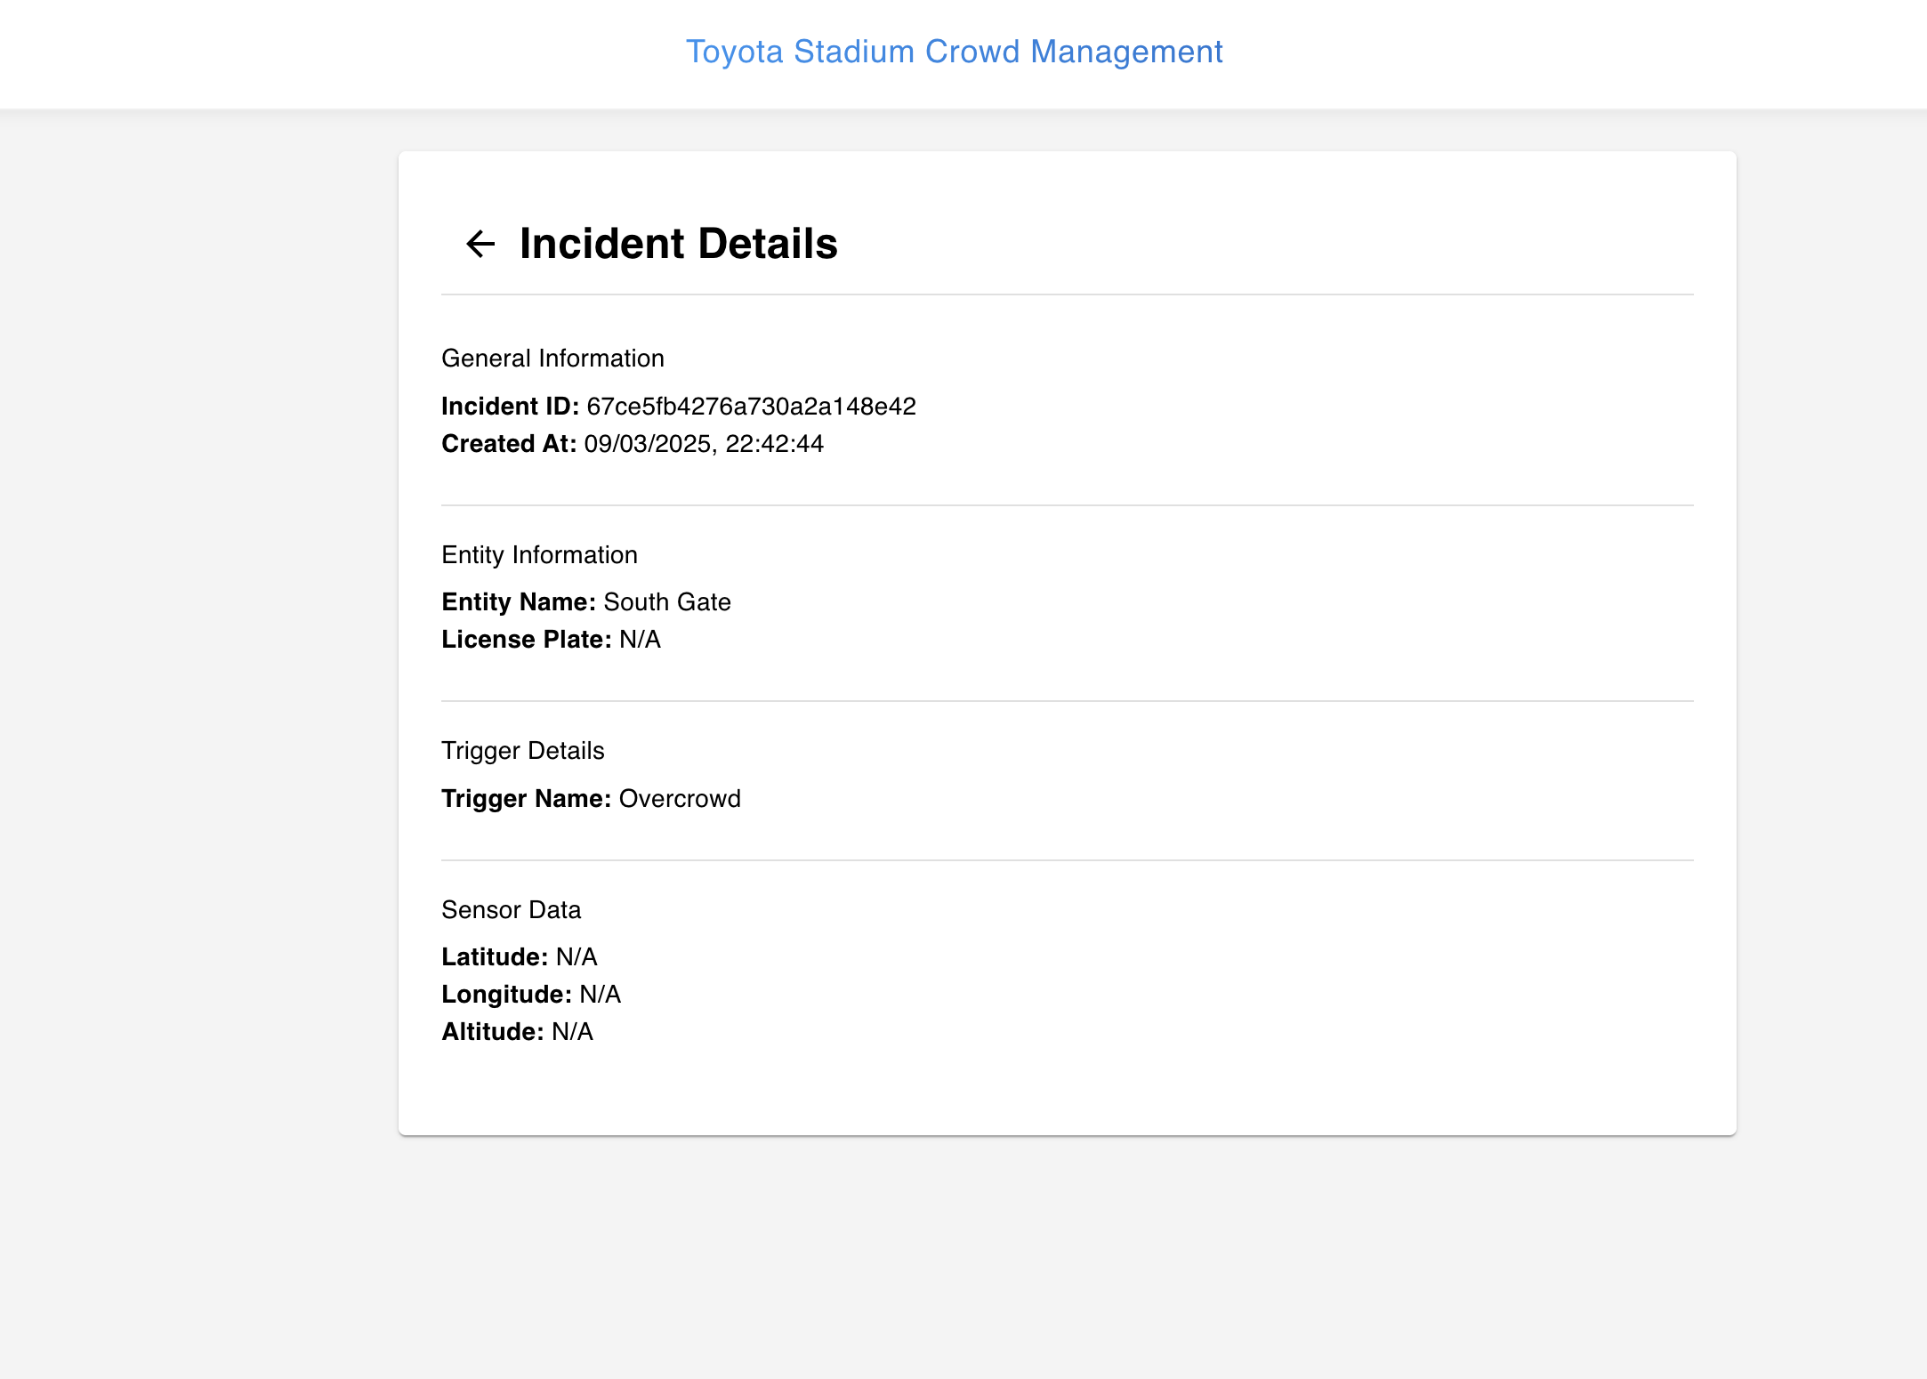
GenAI-Driven Incident Intelligence
GenAI analyzes and contextualizes events:
explains what happened
correlates across cameras + sensors
identifies contributing factors
recommends operational response paths
Structured outputs include:
incident summary
impacted locations / assets
safety implications
escalation recommendations
source references (logs / detections / images)
This helps operators move from:
raw alerts → actionable understanding

Slide 15
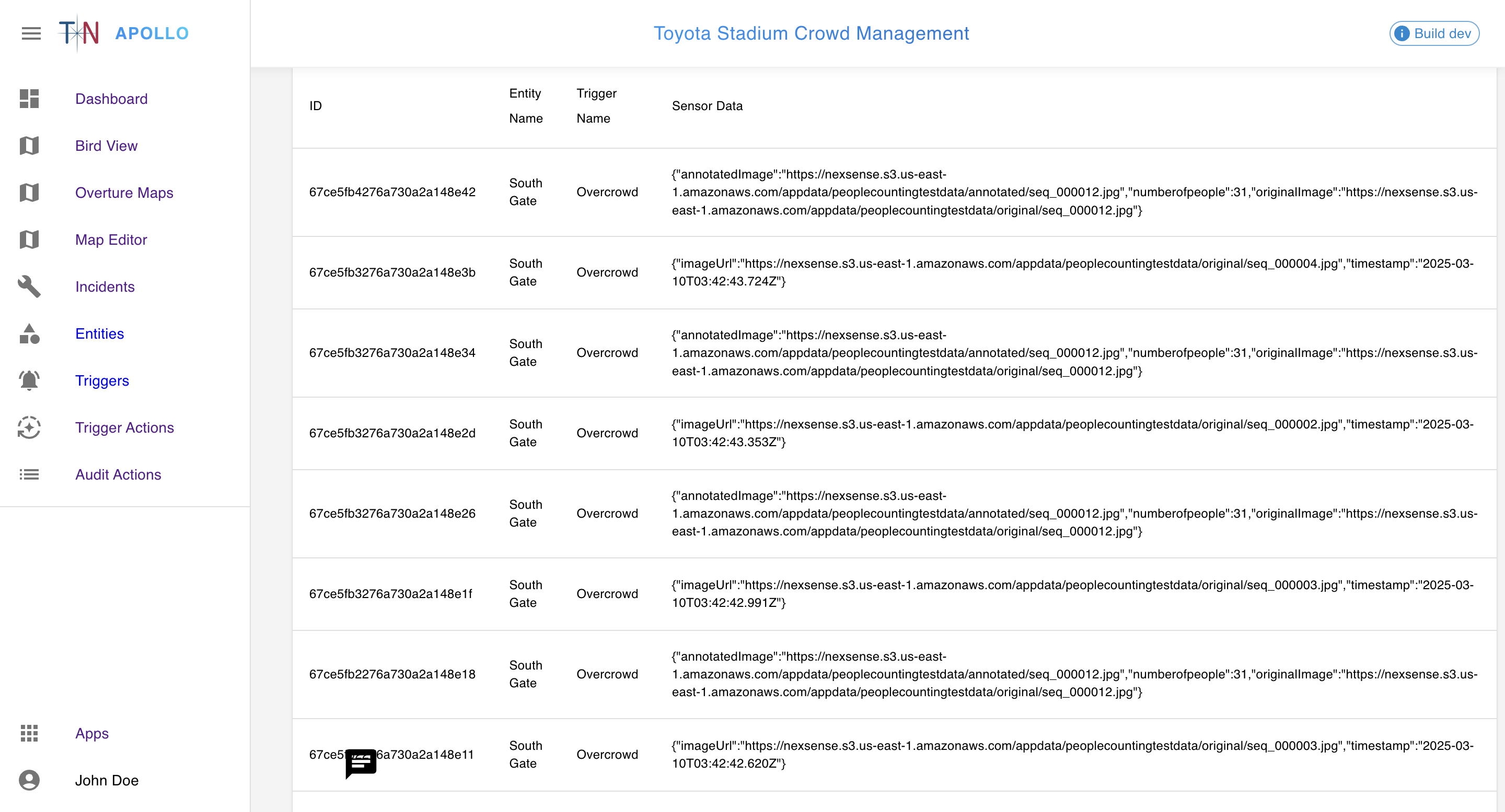
Timeline Replay & Historical Insight
Nexsense supports:
event history timeline
back-in-time navigation
cross-sensor playback
incident evolution tracking
Use cases:
crowd movement reconstruction
operations audit review
safety & risk analysis
“what changed over time” diagnostics

Slide 16
Operator-Focused AI UX
Outputs render as:
structured incident summaries
risk scoring cards
correlation insight panels
recommended playbooks
one-click follow-up actions
The platform enables:
faster response
clearer decision-making
safer operational outcomes

Slide 17
Loopway Positioning
Together, BuildWise and Nexsense demonstrate Loopway’s expertise in:
applied AI system design
structured output engineering
multimodal reasoning
RAG & context fusion
Vision AI + GenAI orchestration
workflow-embedded intelligence
enterprise-grade observability & guardrails
Loopway is positioned as:
an expert partner for designing, implementing, and operationalizing AI systems — not prototypes — but real, production-ready platforms.

